Slide 1

Did non-metro healthcare organizations disproportionately benefit from the United States Paycheck Protection Program (PPP) During the Covid-19 Pandemic? Identifying the differences between metro and non-metro loan recipients in the healthcare sector
Jason Semprini, MPP’
University of Iowa College of Public Health; Department of Health Management and Policy
NIH Fellow, College of Dentistry
Purpose
To identify the differences between non-metro and metro healthcare CARES Act Paycheck Protection Program participants
Background
In the early weeks of the covid-19 pandemic, health systems were treating patients for covid-19, while postponing non-urgent medical services. Escalating costs, combined with the loss of billions in revenue, motivated United States policymakers to include healthcare organizations in the Paycheck Protection Program which provided small businesses with attractive emergency loans. The program was designed to mitigate the effects of economic closures amidst record-breaking unemployment. Early reports, however, suggested that rural businesses were disproportionately benefiting compared to metro businesses. Despite these claims, no study has attempted to evaluate the program by rurality or industry. The ongoing threats to the healthcare system warrant greater attention to this sector’s participation in the program. Additionally, given the dire financial outlook for rural healthcare organizations before the pandemic, a failure to understand the variation in program participation could hinder policy implementation and devastate health inequities as the pandemic continues.
Methods
Comprehensive data became available July 7/6/20 from the U.S. Small Business Administration, which included every program recipient. Recipients were coded as healthcare organizations by the North American Industry Classification System (NAICS) code. Metro status was determined by the Rural-Urban Continuum Code associated with each organization’s zip code. Outcomes included loans, value of loans, and jobs retained per 100,000 population. The analysis aggregated results for the healthcare industry, sectors within the industry, and by legal-status.
Table 1 – Number and proportion of healthcare businesses receiving Paycheck Protection Program (PPP) loans, by metro status
 | Recipients
 | All | Non-Metro | Metro
All | 4,842,901 | 851,393 | 3,991,508
Health Care | 500,092 | 71,818 | 428,274
 | 10.33% | 8.44% | 10.73% | Significant Difference p <0.0001

Slide 2
Did non-metro healthcare organizations disproportionately benefit from the United States Paycheck Protection Program (PPP) During the Covid-19 Pandemic? Identifying the differences between metro and non-metro loan recipients in the healthcare sector
Jason Semprini, MPP’
University of Iowa College of Public Health; Department of Health Management and Policy
NIH Fellow, College of Dentistry
Table 2 – Funds Dispersed, Jobs Retained, and Number of Loans per capita for non-metro and metro healthcare organizations receiving Paycheck Protection Program (PPP) loans.
 | $ Funds Dispersed |  |  | # Jobs Retained |  |  | # Loans
 | non-Metro | Metro |  | non-Metro | Metro |  | non-Metro | Metro
All | 1,608 | 2,128 |  | 16,533 | 18,400 |  | 1,764 | 1,719
Health | 266 | 277 |  | 2,731 | 2,581 |  | 175 | 189
Clinic | 122 | 152 |  | 1,040 | 1,164 |  | 125 | 136
Physician | 71 | 83 |  | 532 | 557 |  | 49 | 52
Dentist | 34 | 37 |  | 299 | 308 |  | 40 | 41
Outpatient Center | 36 | 23 |  | 319 | 181 |  | 14 | 9
other | 30 | 29 |  | 302 | 266 |  | 57 | 47
Hospitals | 177 | 20 |  | 1,342 | 146 |  | 13 | 7
General | 197 | 16 |  | 1,473 | 114 |  | 13 | 6
Psychiatric | 38 | 16 |  | 416 | 143 |  | 8 | 4
Specialist | 28 | 16 |  | 239 | 112 |  | 8 | 4
Long-Term Care | 91 | 74 |  | 1,207 | 876 |  | 27 | 20
Skilled-Nursing Facilities | 66 | 44 |  | 825 | 461 |  | 13 | 7
Residential Facilities | 47 | 24 |  | 552 | 240 |  | 10 | 5
Assisted Living & other facilities | 39 | 28 |  | 502 | 305 |  | 15 | 7
Home Health Agencies | 37 | 32 |  | 587 | 446 |  | 16 | 12
Other & non-clinical | 46 | 58 |  | 650 | 641 |  | 45 | 37
Community Services | 32 | 32 |  | 438 | 346 |  | 23 | 15
Vocational Rehab Services | 23 | 14 |  | 319 | 160 |  | 9 | 4
Diagnostic & Other Ambulatory | 26 | 20 |  | 256 | 177 |  | 16 | 12
Childcare | 11 | 13 |  | 226 | 203 |  | 26 | 16
Table 2 reports the funds dispersed per capita, the number of jobs retained per 100,000 population, and number of loans per 100,000 population for both metro and non-metro regions in the United States.

Slide 3
Did non-metro healthcare organizations disproportionately benefit from the United States Paycheck Protection Program (PPP) During the Covid-19 Pandemic? Identifying the differences between metro and non-metro loan recipients in the healthcare sector
Jason Semprini, MPP’
University of Iowa College of Public Health; Department of Health Management and Policy
NIH Fellow, College of Dentistry
Table 3 – Funds Dispersed, Jobs Retained, and Number of Loans per capita for non-metro and metro healthcare organizations receiving Paycheck Protection Program (PPP) loans, for non-profits, small businesses, and corporations.
 |  | $ Funds Dispersed |  |  | # Jobs Retained |  |  | # Loans
 |  | non-Metro | Metro |  | non-Metro | Metro |  | non-Metro | Metro
Not-for-Profits | All | 143 | 65 |  | 1,353 | 591 |  | 25 | 13
 | Clinics | 64 | 37 |  | 519 | 263 |  | 9 | 5
 | Hospitals | 310 | 70 |  | 2,303 | 511 |  | 13 | 4
 | Long-Term Care | 79 | 53 |  | 900 | 495 |  | 12 | 5
 | other | 34 | 33 |  | 436 | 334 |  | 18 | 10
Small Businesses | All | 15 | 16 |  | 163 | 148 |  | 45 | 38
 | Clinics | 13 | 13 |  | 116 | 108 |  | 35 | 31
 | Hospitals | 11 | 3 |  | 84 | 23 |  | 9 | 4
 | Long-Term Care | 10 | 5 |  | 122 | 59 |  | 11 | 6
 | other | 3 | 2 |  | 56 | 29 |  | 20 | 9
Corporations | All | 160 | 205 |  | 1,717 | 1,920 |  | 125 | 140
 | Clinics | 95 | 125 |  | 813 | 951 |  | 97 | 104
 | Hospitals | 59 | 15 |  | 479 | 105 |  | 11 | 6
 | Long-Term Care | 67 | 58 |  | 944 | 725 |  | 22 | 16
 | other | 28 | 33 |  | 396 | 383 |  | 26 | 24
Table 3 reports the funds dispersed per capita, the number of jobs retained per 100,000 population, and number of loans per 100,000 population for both metro and non-metro regions in the United States.

Slide 4
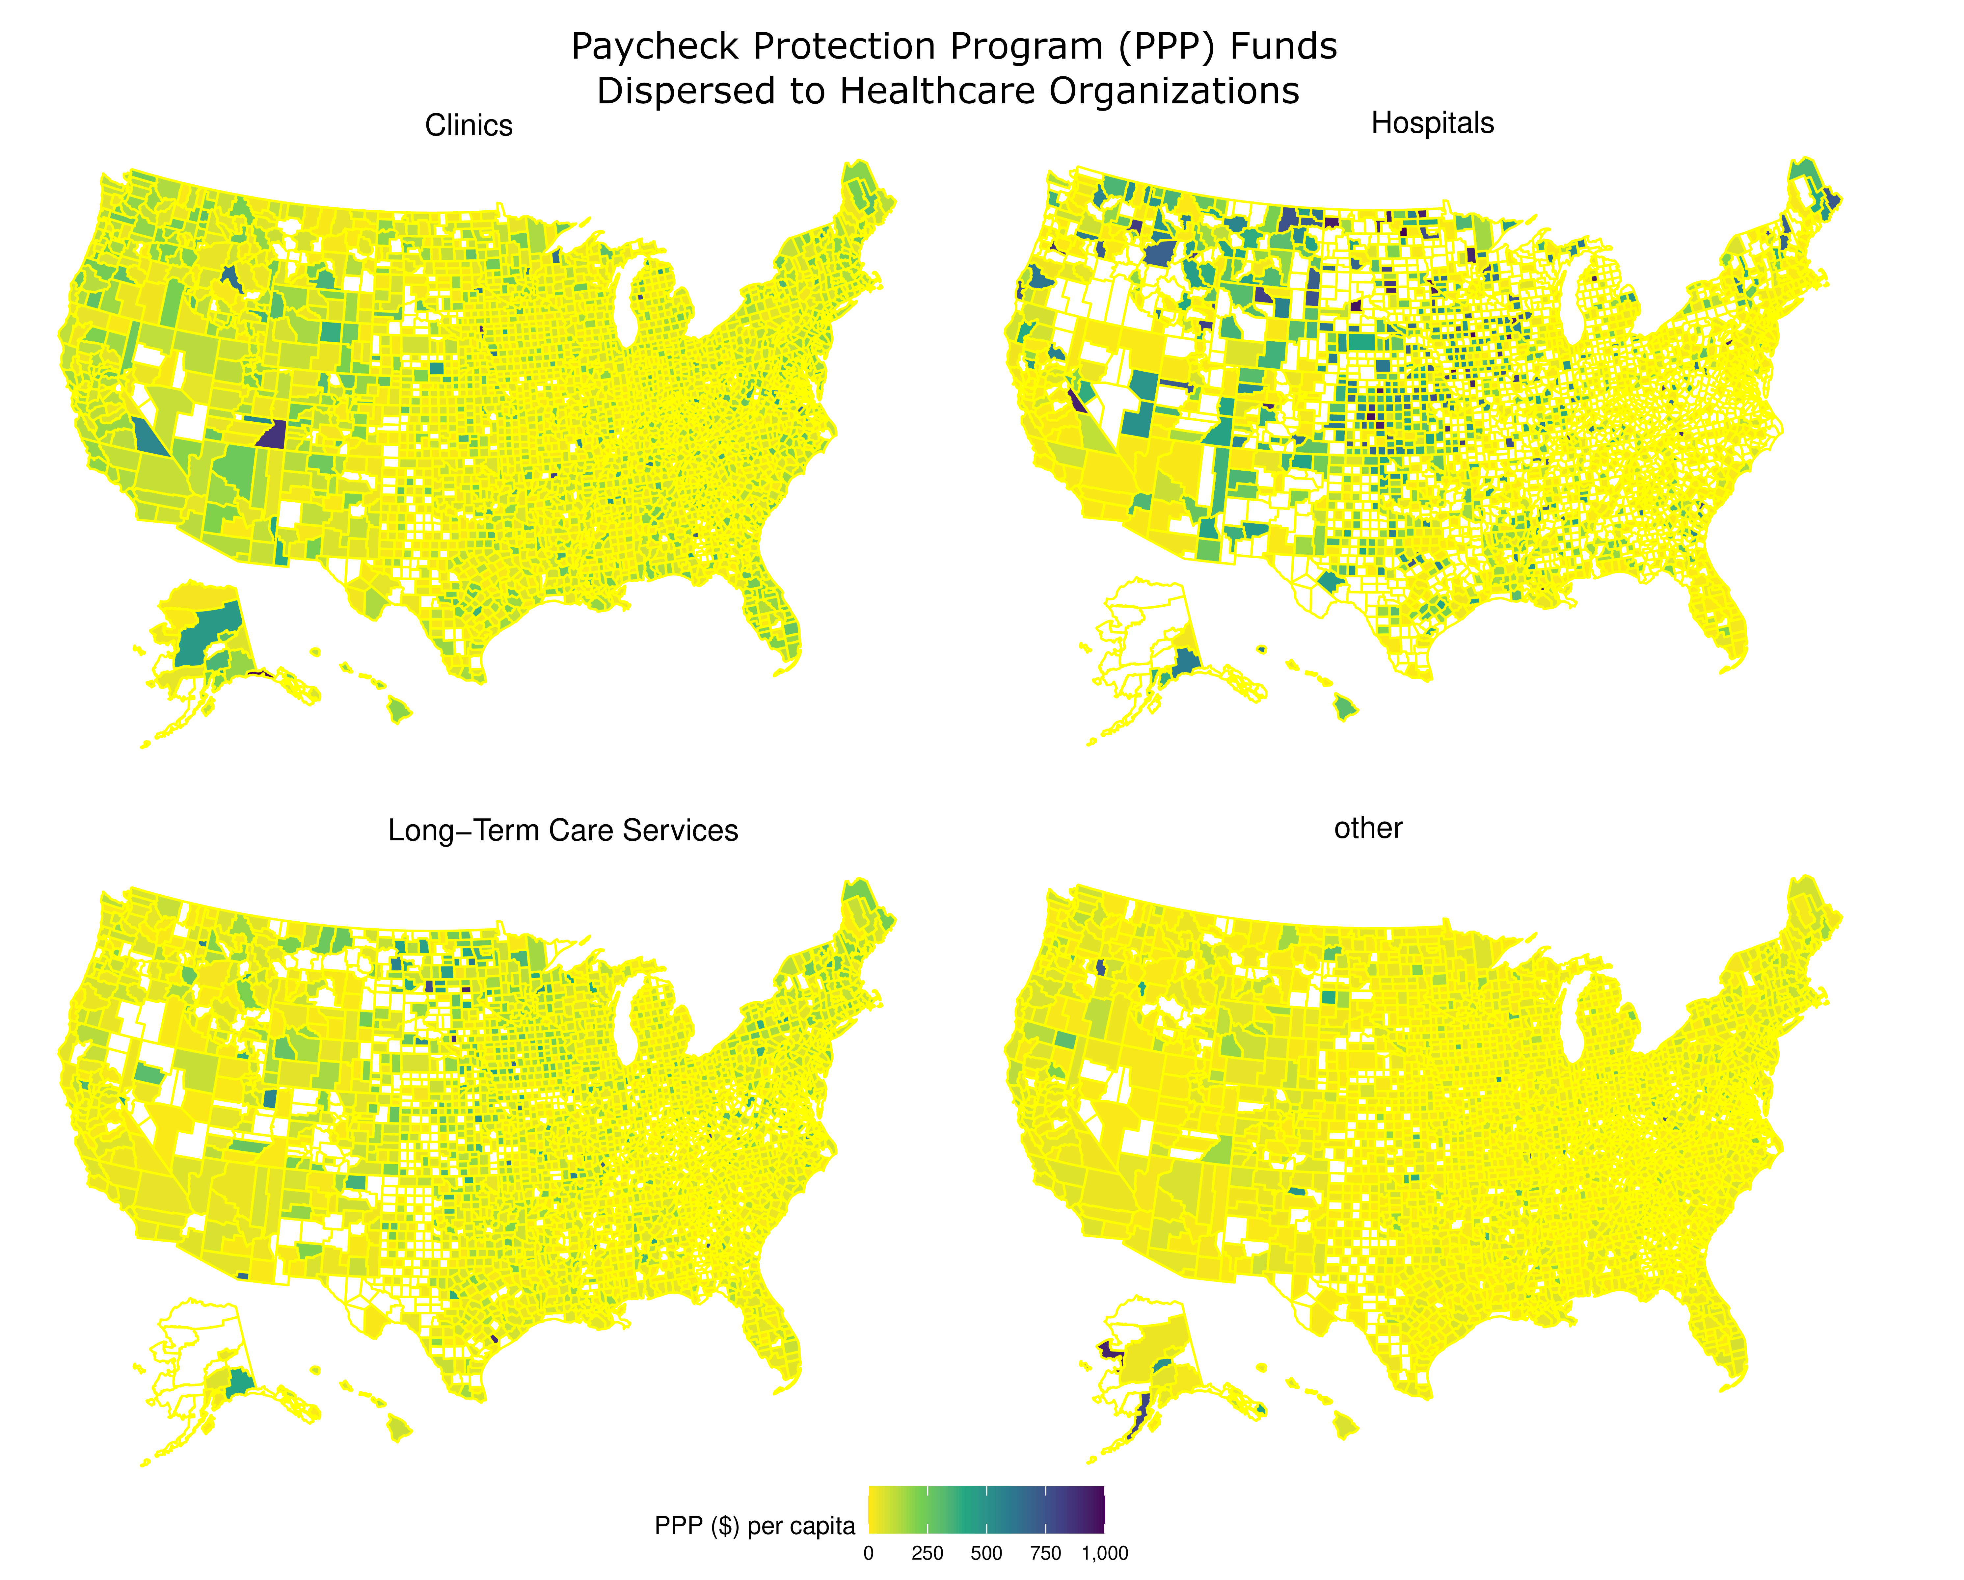
Did non-metro healthcare organizations disproportionately benefit from the United States Paycheck Protection Program (PPP) During the Covid-19 Pandemic? Identifying the differences between metro and non-metro loan recipients in the healthcare sector
Jason Semprini, MPP’
University of Iowa College of Public Health; Department of Health Management and Policy
NIH Fellow, College of Dentistry
Conclusions
*This study finds that metro healthcare organizations may slightly benefit relative to non-metro organizations. ,
*Despite being designed for small businesses, a disproportionate share of loans went to corporate healthcare organizations.
*Among healthcare organizations, the largest number of retained jobs came from loans to non-profit hospitals in non-metro regions.
*The pandemic has reminded policymakers of the critical importance of non-profit hospitals and long-term care providers in rural areas.
*Future research should continue investigating program variation, but more importantly evaluate this variation on short-term outcomes during the pandemic and the long-term financial solvency of rural providers.

